Slide 1

Flows from a heart that’s filled with the awe of the LORD
PSALM 8

Slide 2


Slide 3


Slide 4
v.1.
“O LORD our Lord…”

Slide 5
v.1.
“…how majestic is your name in all the earth...”

Slide 6
v. 1.
“…You have set your glory above the heavens.

Slide 7
v.2.
Out of the mouth of babies and infants,

Slide 8
“…you have
established strength (praise)
because of your foes...”

Slide 9
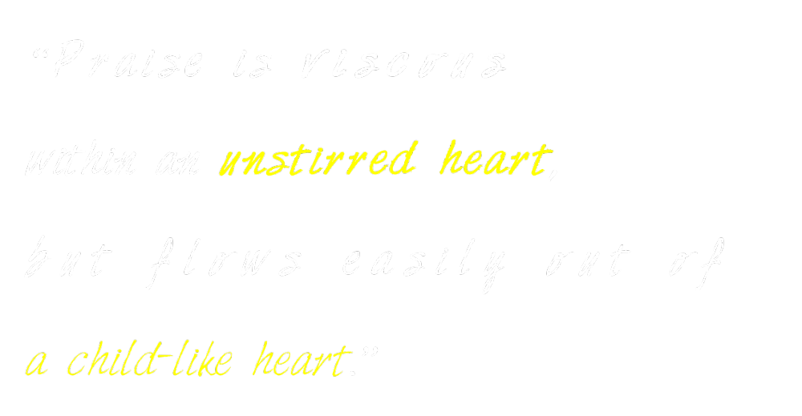

Slide 10
v.3
When I look at your heavens, the work of your fingers, the moon and the stars, which you have set in place,

Slide 11
V. 4
“WHAT IS MAN THAT YOU ARE MINDFUL OF HIM, AND THE SON OF MAN THAT YOU CARE FOR HIM?”

Slide 12
vv. 3-4
"When I consider… that you care for him (or visit him)…”

Slide 13
Psalm 144:3-7.
“LORD, what is man, that You take knowledge of him?
Or the son of man, that You are mindful of him?
Man is like a breath; his days are like a passing shadow.”

Slide 14
Psalm 106:4-5.
“Remember me, O LORD,
with the favor You have toward Your people;
Oh, visit me with Your salvation...”

Slide 15
V.5-8.
Yet you have made him a little lower than the heavenly beings and crowned him with glory and honor.

Slide 16
1 Cor. 1:27.
But God has chosen the foolish things of the world
to put to shame the wise,
and God has chosen the weak things of the world
to put to shame the things which are mighty.

Slide 17
Heb. 2:6-7, 9
(quoting Psalm 8:4-6)
…"What is man, that you are mindful of him, or the son of man, that you care for him? You made him for a little while lower than the angels; you have crowned him with glory and honor,
... But we see him who for a little while was made lower than the angels,
namely Jesus, crowned with glory and honor because of the suffering of death,
so that by the grace of God He might taste death for everyone.

Slide 18
Heb. 2:14
(quoting Psalm 8:4-6)
Since therefore the children share in flesh and blood, (mankind)
he (Jesus) himself likewise partook of the same things (incarnation),
that through death (even death on a cross)
he (Jesus) might
destroy the one who has the power of death,
that is, the devil,

Slide 19
Heb 2:8.
(The fulfillment of the Psalm (VV. 6-8)
“… putting everything in subjection under his feet."

Slide 20
1 Cor. 1:28-29.
God chose what is low and despised in the world,
even things that are not, (of no consequence)
to bring to nothing things that are,
so that no human being might boast in the presence of God.

Slide 21
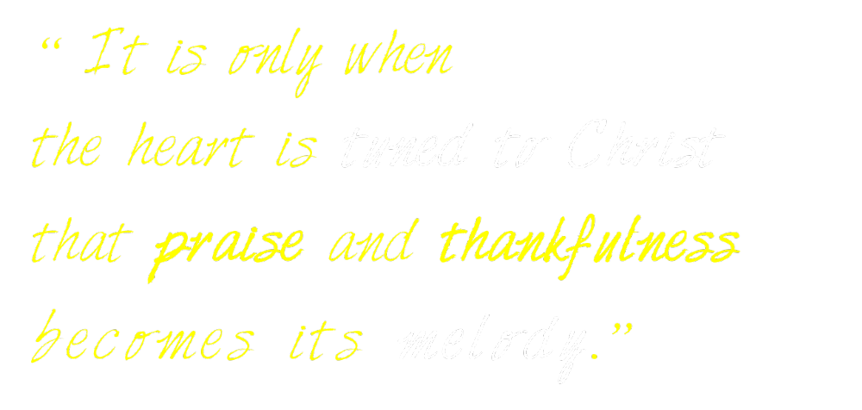

Slide 22
TWO QUESTIONS
Is the LORD your Lord (the Sovereign, Adonai) through trust in Jesus alone?
Is a lifestyle of thankfulness evident to all because your heart is gripped by the awe of God?

